Slide 1

[Samsung PRISM] Weekly Review
AI/ML Based Network Device Software upgrade in SDN Controlled Network
Team
College Professor(s): Dr.P. PRAKASAM / prakasam.p@vit.ac.in
Students:
SAKSHI A. RAGHAVAN / sakshiraghavan.a2020@vitstudent.ac.in
JAYA SRI KRISHNA.S / jayasri.krishna2020@vitstudent.ac.in
JANARTHANAN.P.M / janarthanan.pm2020@vitstudent.ac.in
Department: ECE

Slide 2

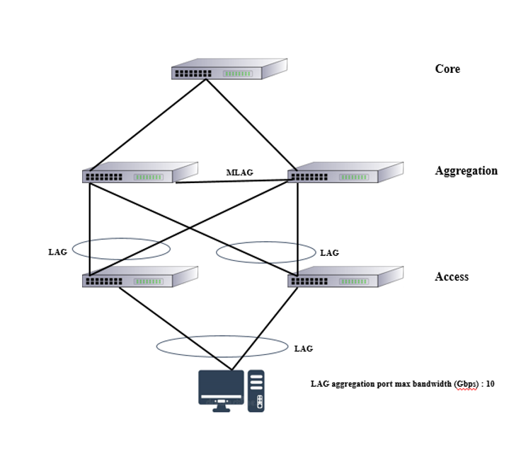
CSW23 | AI/ML Based Network Device Software upgrade in SDN Controlled Network
ARCHITECTURE
Srevatsa, Director
Vanraj, Manager
Notes:
-

Slide 3
Literature survey and study
Major Observations / Conclusions:
(provide details about your findings, experimental opinion – Use separate slide if necessary)
Madhukrishna Priyadarsini, Padmalochan Bera,“Software defined networking architecture, traffic management, security, and placement: A survey”, Computer Networks,Volume 192, 2021, 108047, ISSN 1389-1286, https://doi.org/10.1016/j.comnet.2021.108047. (https://www.sciencedirect.com/science/article/pii/S1389128621001481)
The main contribution of the paper includes:
(1)Study on SDN implementation architecture covering its evolution from OpenFlow and network function virtualization (NFV). The working procedure of each layer and the functional components (network devices) are presented along with the flow rule generation process.
(2)The traffic management challenges in SDN mainly in the form of load balancing and energy-efficient routing; Following these there’s detailed the state-of-the-art research in these directions.
(3)state the controller placement problem in SDN. Research insights to solve this problem considering different network and traffic management constraints are presented.
(4)Presentation of detailed theoretical, experimental, and analytical comparison of state-of-the-art works in all the above directions plus security. We also discuss the dependencies of these problems with effective traffic management in SDN.

Slide 4
Literature survey and study
Major Observations / Conclusions:
(provide details about your findings, experimental opinion – Use separate slide if necessary)
Hong Zhong, Yaming Fang, Jie Cui, “LBBSRT: An efficient SDN load balancing scheme based on server response time”, Future Generation Computer Systems, Volume 68,2017,Pages 183-190,ISSN 0167-739X, https://doi.org/10.1016/j.future.2016.10.001.
(https://www.sciencedirect.com/science/article/pii/S0167739X16303727)
The paper’s gist:
The paper talks about the “response time” enhancement compared to the traditional server cluster load balancing scheme, as the latter is limited by the hardware conditions, and cannot completely exploit the server response times for load balancing.
In order to effectively resolve the traditional load balancing schemes, the paper proposes a load balancing scheme based on server response times by using the advantage of SDN flexibility, named LBBSRT.
Using the real-time response time of each server measured by the controller for load balancing, they process user requests by obtaining an evenly balanced server loads.
The paper supports their finding by quoting that the simulation experiments show that the proposed scheme exhibits a better load balancing effect and process requests with a minimum average server response times.
In addition, the paper promises that the proposed scheme is easy to implement, and exhibits good scalability and low cost characteristics.

Slide 5
Literature survey and study
Major Observations / Conclusions:
(provide details about your findings, experimental opinion – Use separate slide if necessary)
Sahu, Himanshu, Raj Gaurang Tiwari and Sumit Kumar. “SDN-Based Traffic Monitoring in Data Center Network Using Floodlight Controller.” International Journal of Intelligent Information Technologies (2022): n. pag., DOI:10.4018/ijiit.309590 Corpus ID: 252470534
(https://api.semanticscholar.org/CorpusID:252470534)
The paper’s gist:
The targeted Dataset comes from Data center networks for this paper.
The paper focuses to propose a proper management of elephant traffic flows so that it can enhance overall performance and energy efficiency in Software-defined network (SDN) that provides a centralized control plane (i.e., controller).
The controller can be utilized for traffic monitoring by collecting the network flows at the controller.
In this research, a new mechanism has been provided to detect such flows, which requires continuous polling of all switches. The proposed method depends on passive querying so it does not require additional traffic. The result shows the successful detection of elephant flow and cheetah flow that can be rerouted to improve the quality of service (QoS).

Slide 6
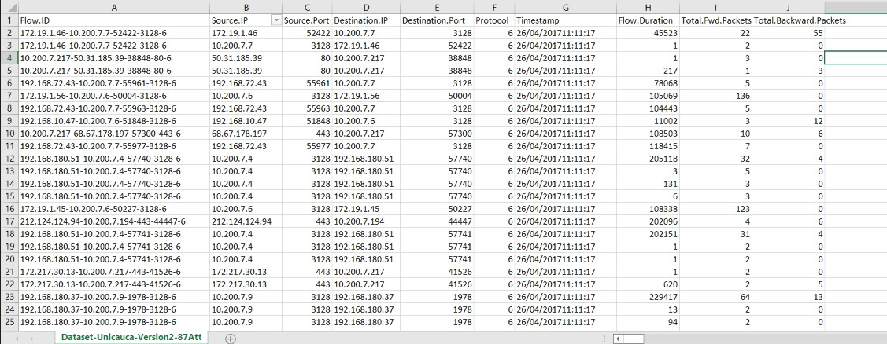
Literature survey and study
Major Observations / Conclusions:
(provide details about your findings, experimental opinion – Use separate slide if necessary)
DATASET FOUND:
Site:
https://www.kaggle.com/datasets/jsrojas/ip-network-traffic-flows-labeled-with-87-apps

Slide 7
Queries
Challenges :
(Discuss in the form of bullets, what are the next action steps, any road blocks / bottlenecks)

Slide 8
Thank you

